Slide 1
Project Faraday
Anton Mihai - Avram Cosmin - Badita Georgian

Slide 2
Contents
Purpose
Proposed solution
Object detection techniques
Our approach
Improvements
Real tests
Future work

Slide 3
Purpose
Bring safety to the streets by building an autonomous system for pedestrian tracking and action prediction.

Slide 4
Proposed solution
YOLOv3 and DeepSort algorithms for an accurate and fast object detection
Anomaly detection algorithms

Slide 5

Proposed solution

Slide 6
Object detection
Sliding window with CNN prediction
R-CNN detection
YOLO - you only look once

Slide 7
How do they work - CNN + sliding window
Fixed size sliding windows on each possible location on the picture
Prediction for each iteration -> select the most probable class
Pros: high precision
Cons: time and memory consuming

Slide 8
How do they work - R-CNN
Selective search for regions in the image
Prediction for a fixed number of regions
Pros: high precision, a bit faster that the sliding window approach
Cons: still not real-time

Slide 9
How do they work - Fast R-CNN
Creates feature map before selective search
Merges multiple overlapping bounding boxes
Pros: high precision, a bit faster that the sliding window approach
Cons: still not real-time

Slide 10
How do they work - YOLO
Looks at the image once, hence the name
Splits the image into an SxS grid -> predicts a class for each
Pros: real-time detection
Cons: struggles with small objects

Slide 11
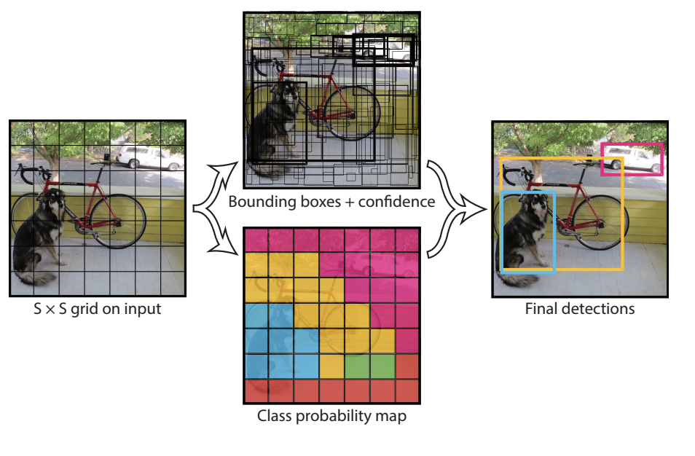

Slide 12
Our approach
3 step pipeline
Object detection
Pedestrian tracking
Action prediction

Slide 13
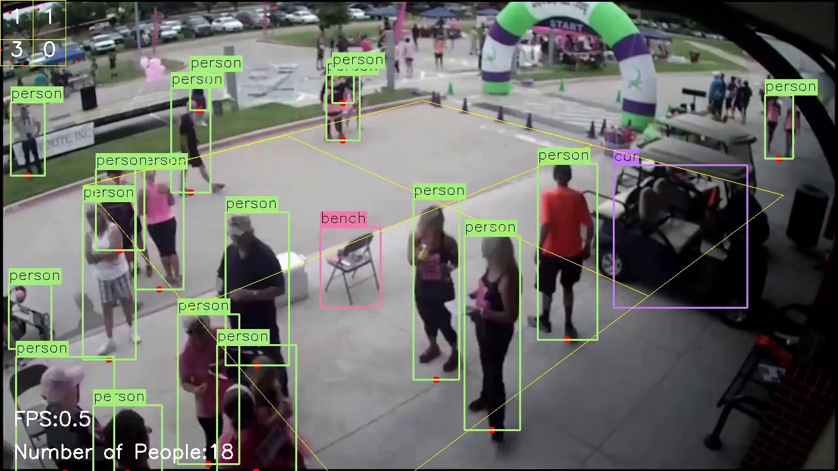
Object detection
Using Yolo due to real time demands
Retrained model to have a higher bias on pedestrians

Slide 14
Pedestrian tracking
Using DeepSort
Using a technique similar to clustering
Assigning an unique ID for each pedestrian

Slide 16
Anomaly detection
Using LSTM autoencoders for learning the normal flow
Errors in reconstruction -> anomaly in walking pattern

Slide 17
Improvements
Trained on custom datasets
Retrained with bias on pedestrians
Custom configuration for better predictions

Slide 18
Real tests
We’ll present 3 cases, so we can compare the two algorithms
Pedestrians seen from above
Traffic
Close pedestrians

Slide 19
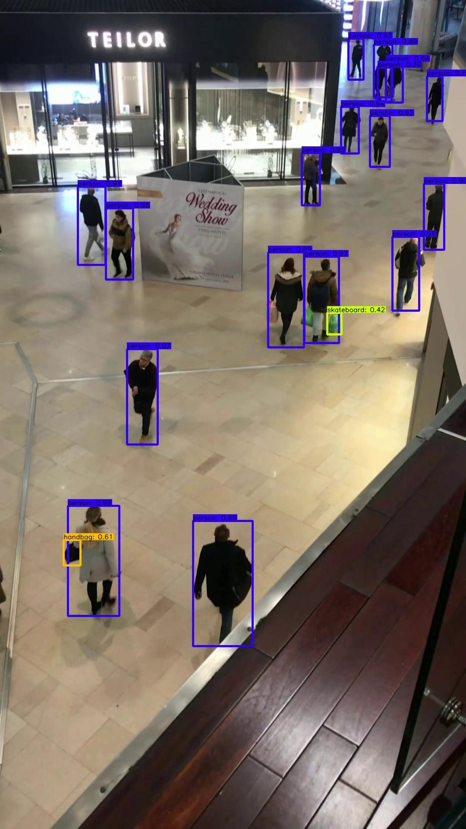
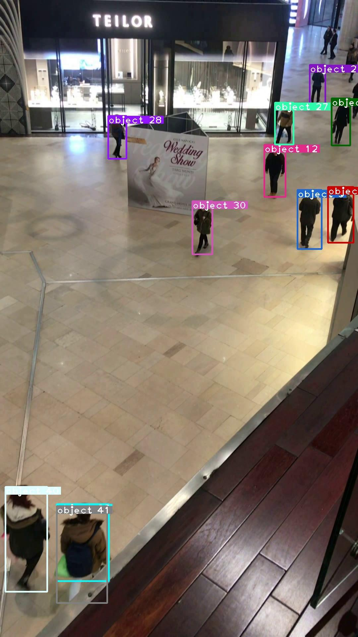
Pedestrians seen
from above
Yolo
Deepsort

Slide 20
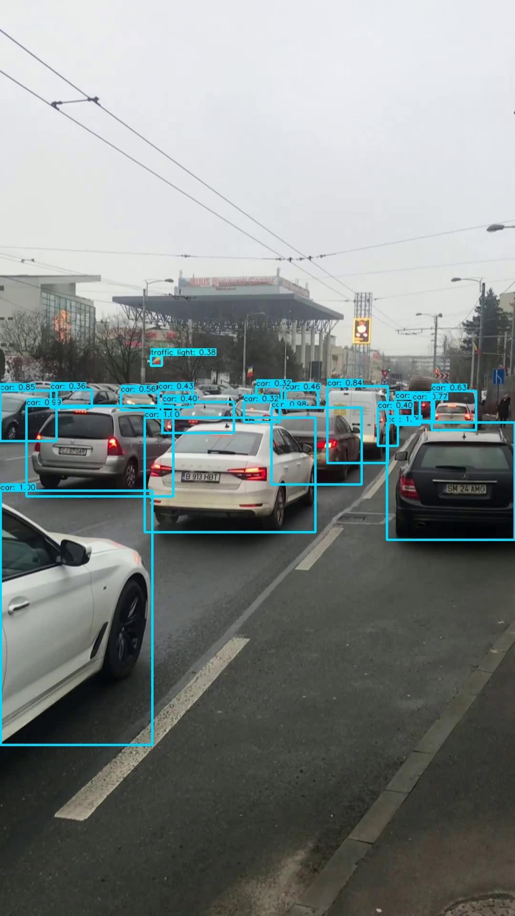
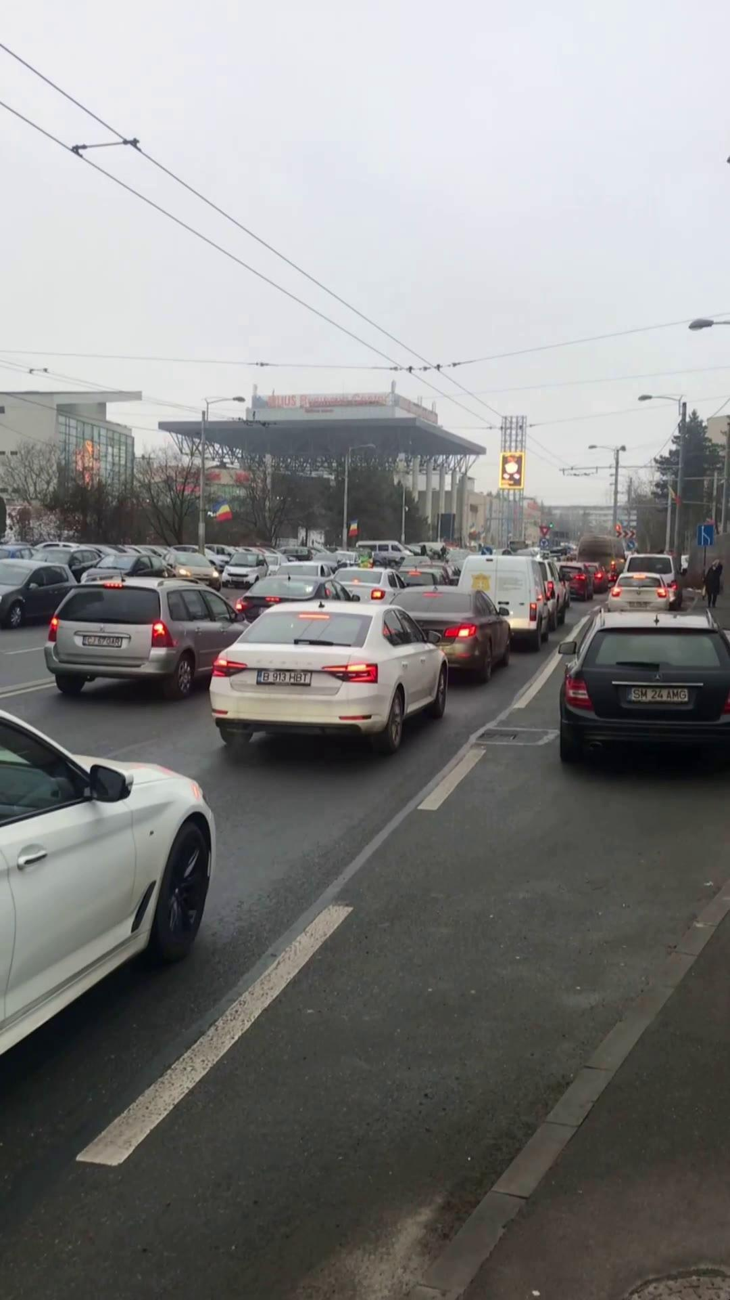
Traffic
Yolo
Deepsort

Slide 21
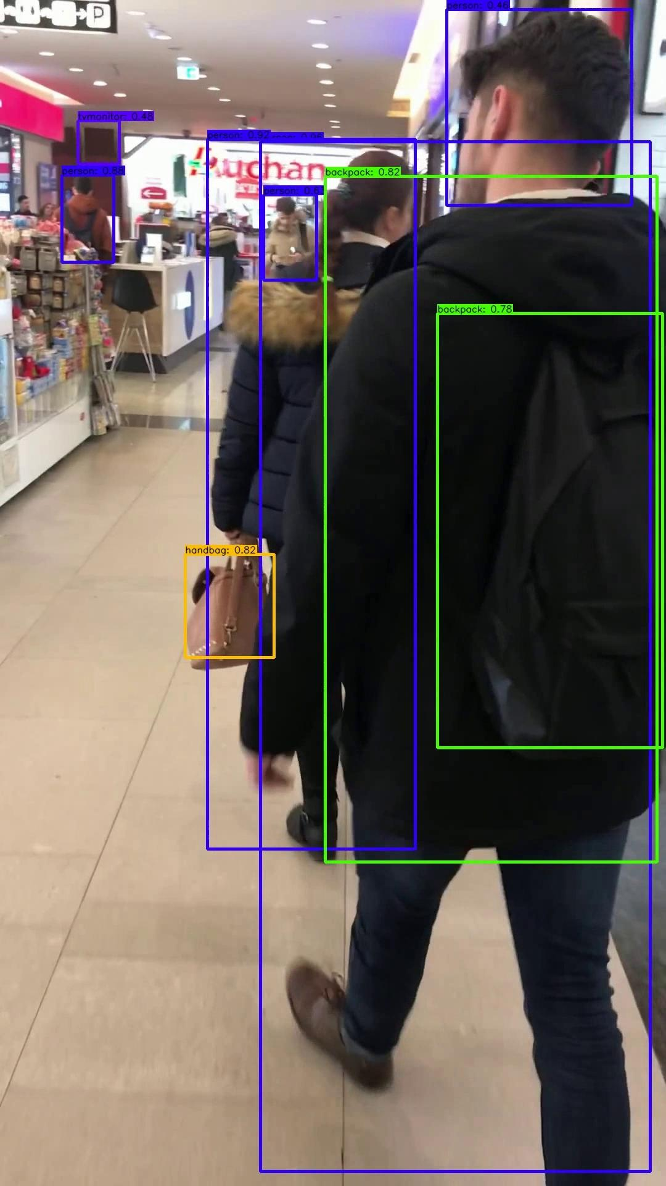
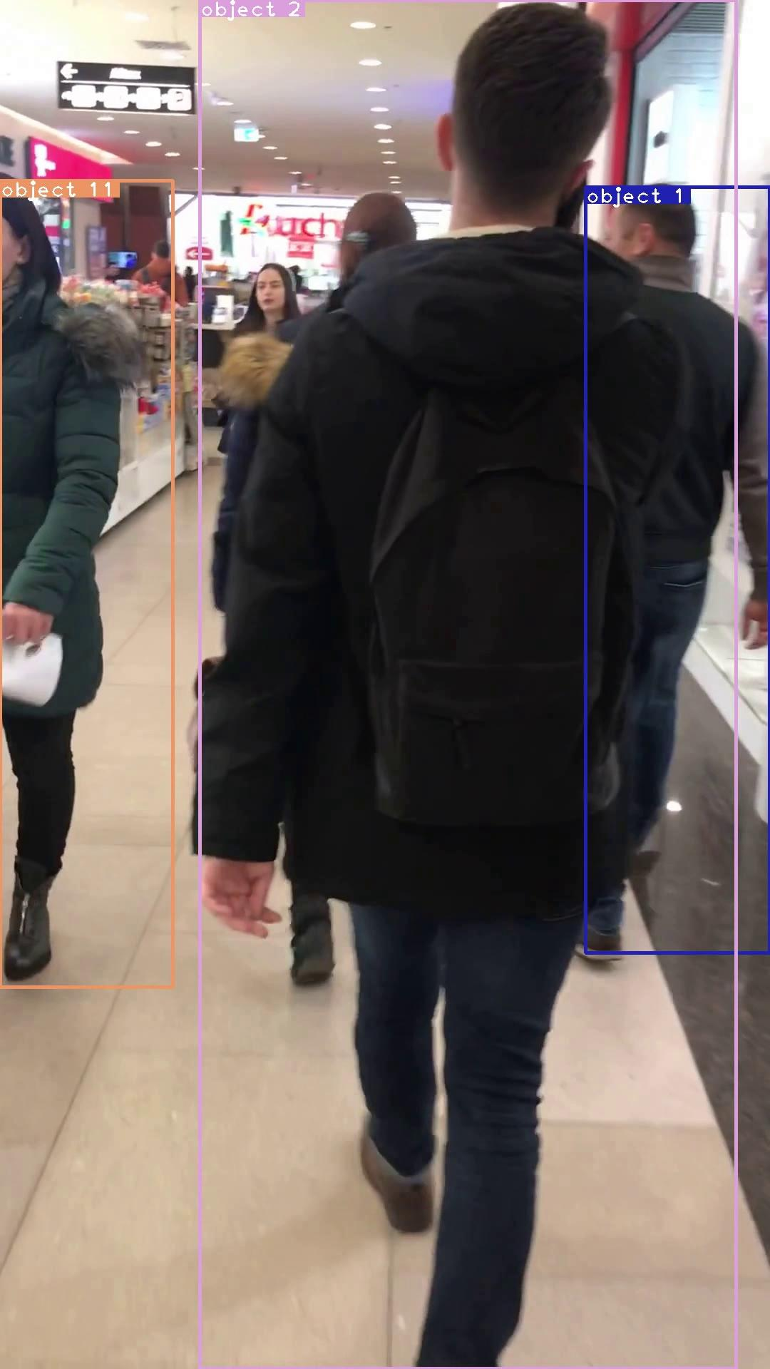
Close pedestrians
Yolo
Deepsort

Slide 22
Future work
Anomaly detection
Further training of the models

Slide 23
Conclusion
5% better model after transfer learning
IoU increased

